Slide 1
AOC Proposal
第三組 - 大禹治水，小郭治洪

Slide 2

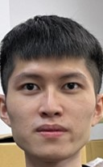


Member List
黃雍翔：Model design、Model training
陳冠穎：DMA design、PE design
王文楷： DMA design、PE design
陳冠穎
黃雍翔
王文楷

Slide 3
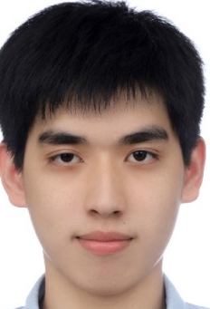
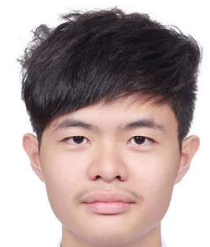
Member List
蔡明翰： DMA design、PE design
胡家豪： Model design、Power unit design
蔡明翰
胡家豪

Slide 4
Outline
Purpose
Basis
System overview
DLA architecture & Memory hierarchy
Dataflow & Network on chip
Analysis
Innovation

Slide 5
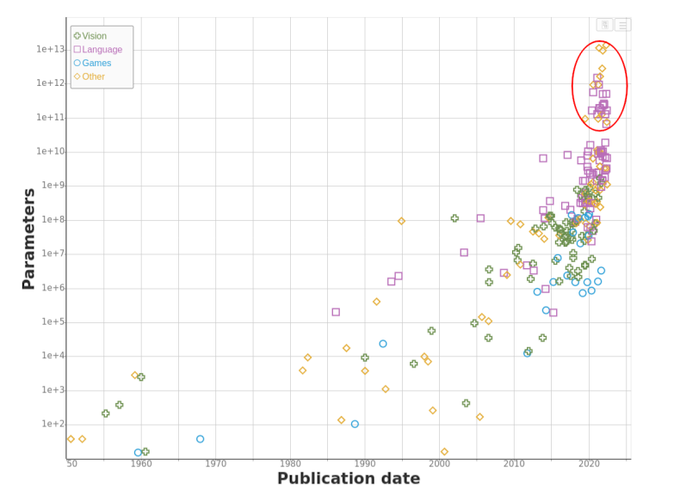
Purpose
As neural networks advance, a large number of parameters can burden memory resources.
Heavy computational demands on mobile devices can lead to significant power consumption

Slide 6
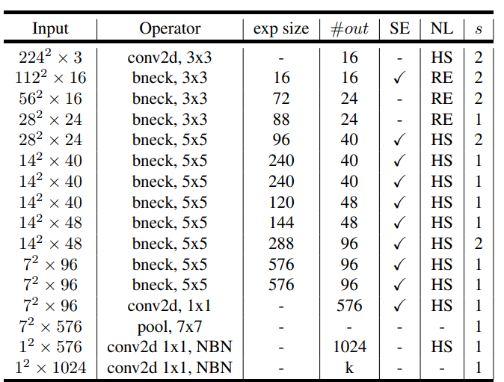
Basis- MobileNet V3
Separate the normal convolution to Depthwise convolution and pointwise convolution to reduce parameters
Adding Squeeze-and-Excitation (SE) block to increase accuracy
Replace ReLU with h-Swish activation function to capture more non-linear relationship

Slide 7
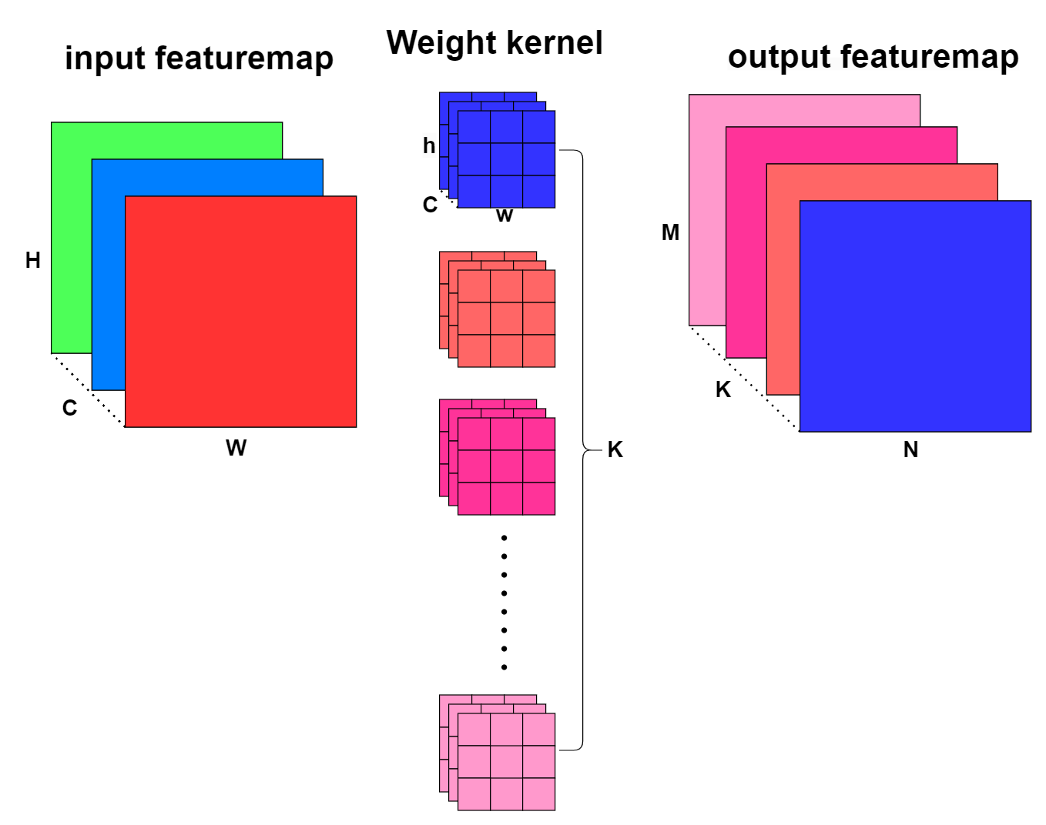
Normal convolution

Slide 8
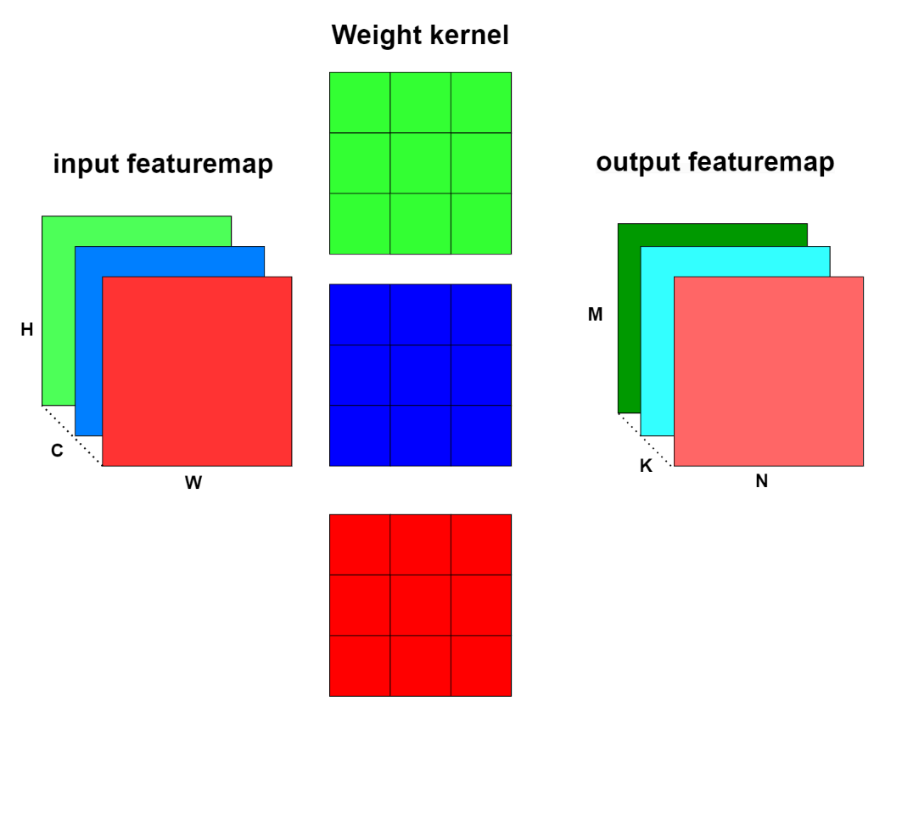
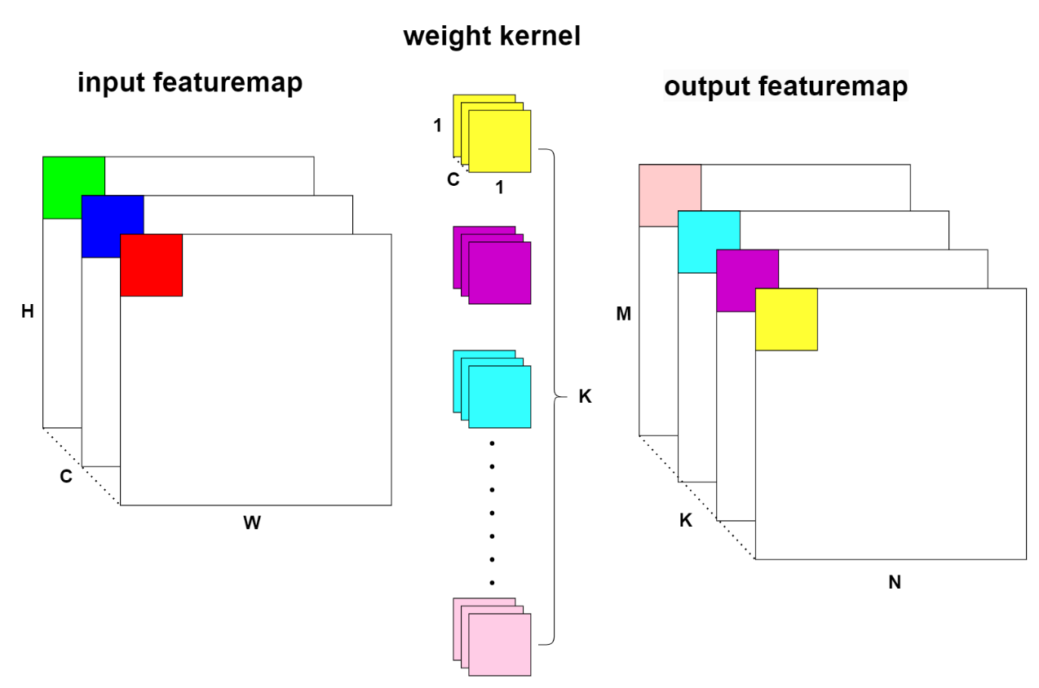
Depthwise convolution & Pointwise convolution
(a) Depthwise convolution
(b) Pointwise convolution

Slide 9
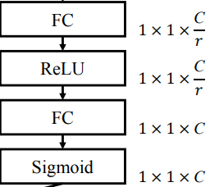
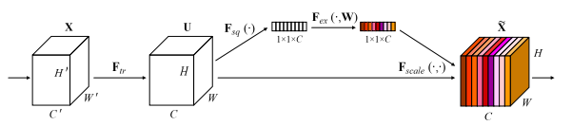
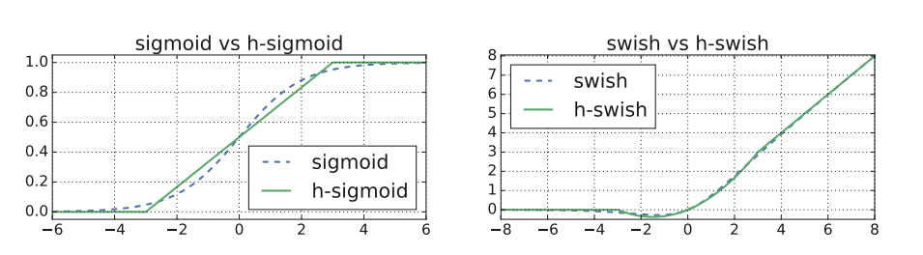
Squeeze-and-Excitation block
(a) SE block
(b) SE module
Different choice of Nonlinearities
(c) Activation comparison

Slide 10
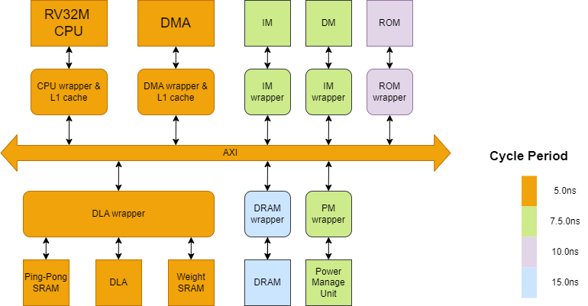
System overview

Slide 11
Supported tasks
Standard convolution
Depthwise convolution
Pointwise convolution
Average & Max pooling
Fully connected layer
Residual
Relu
h-Swish

Slide 12
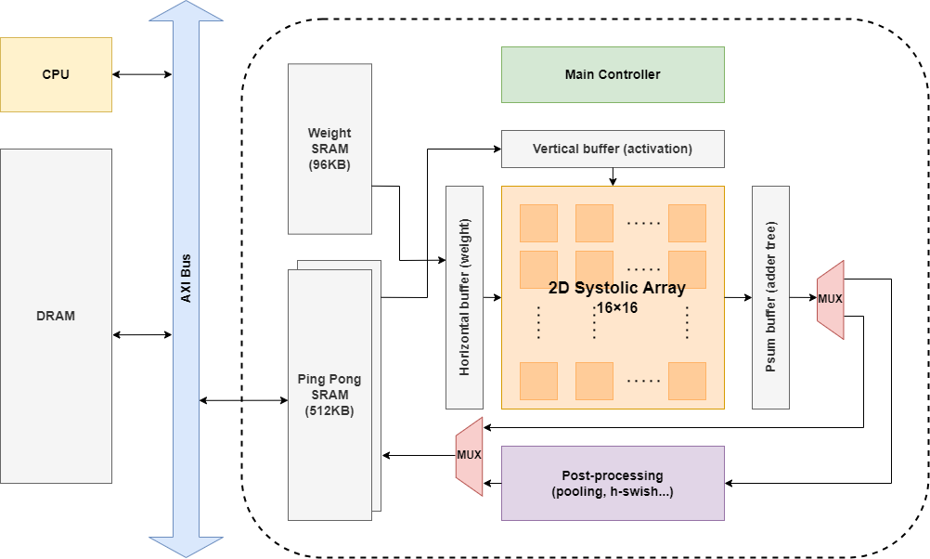
DLA architecture & Memory hierarchy

Slide 13
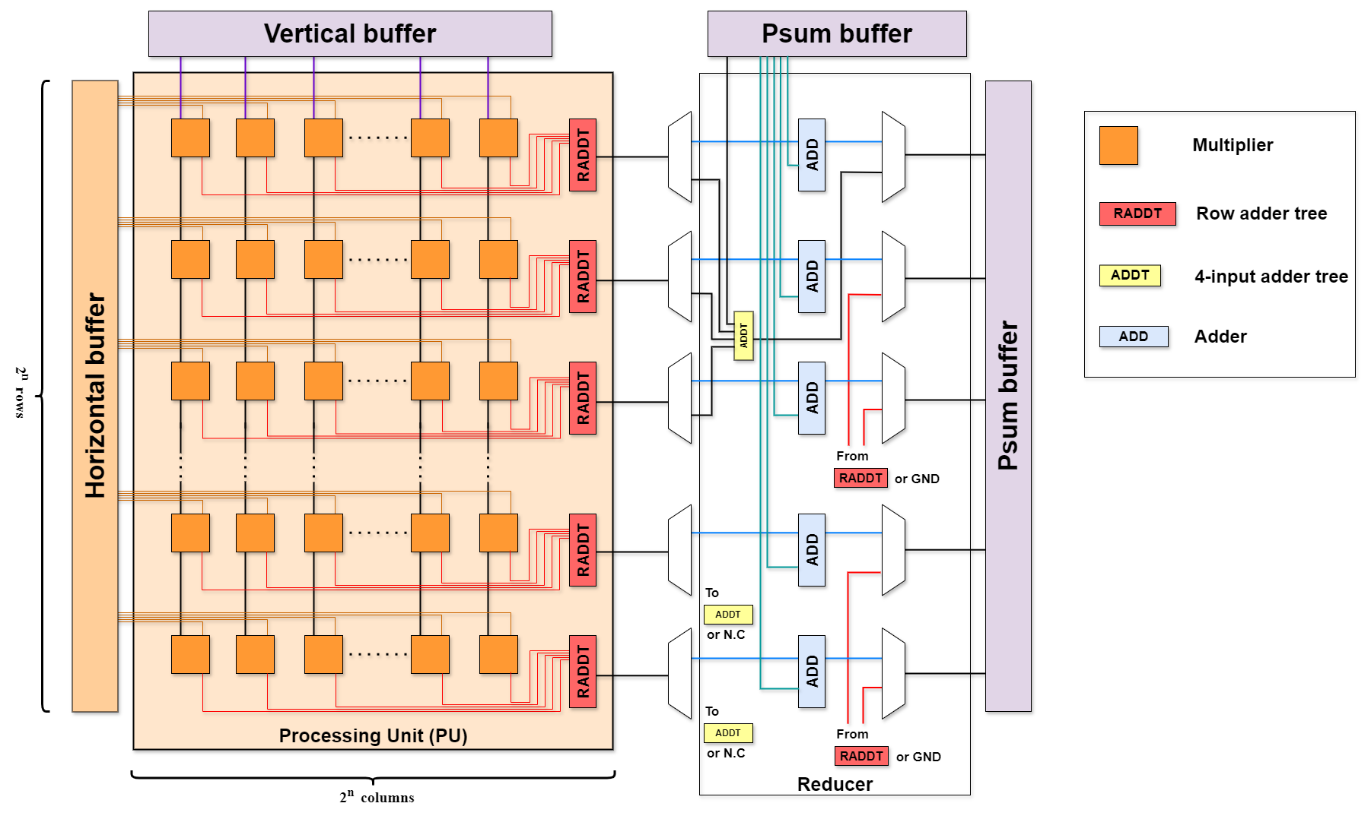
Network on chip

Slide 14
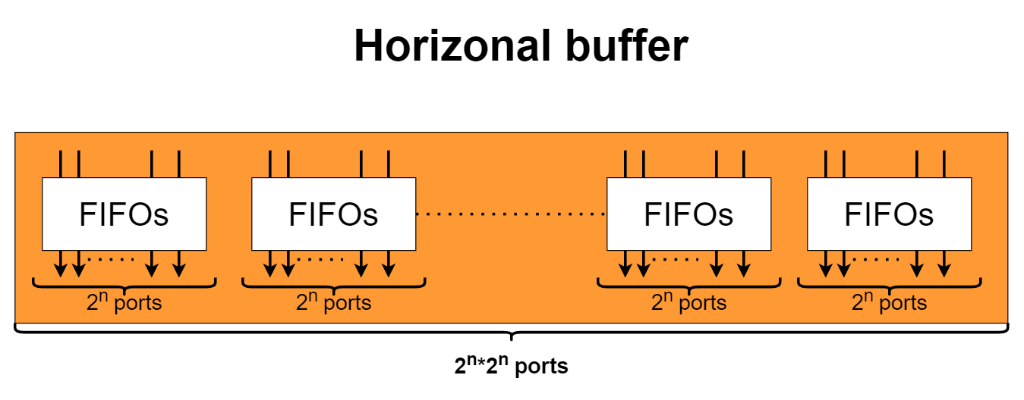
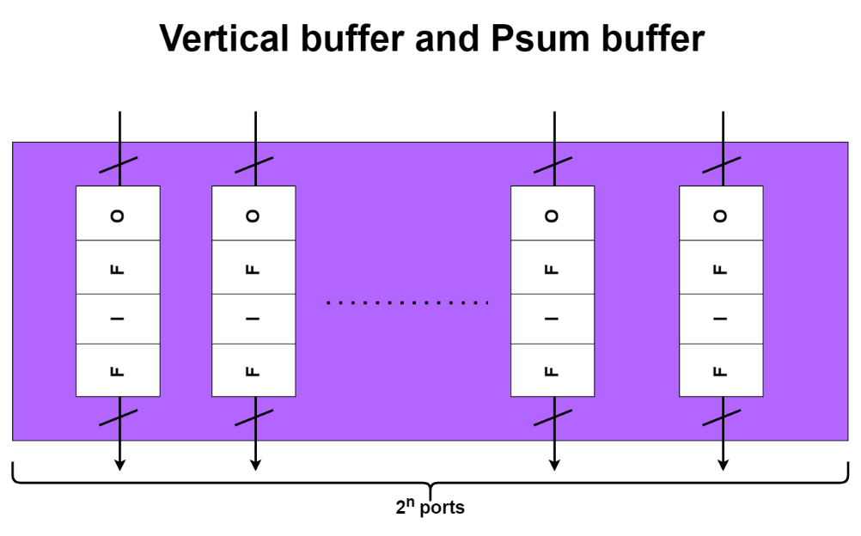
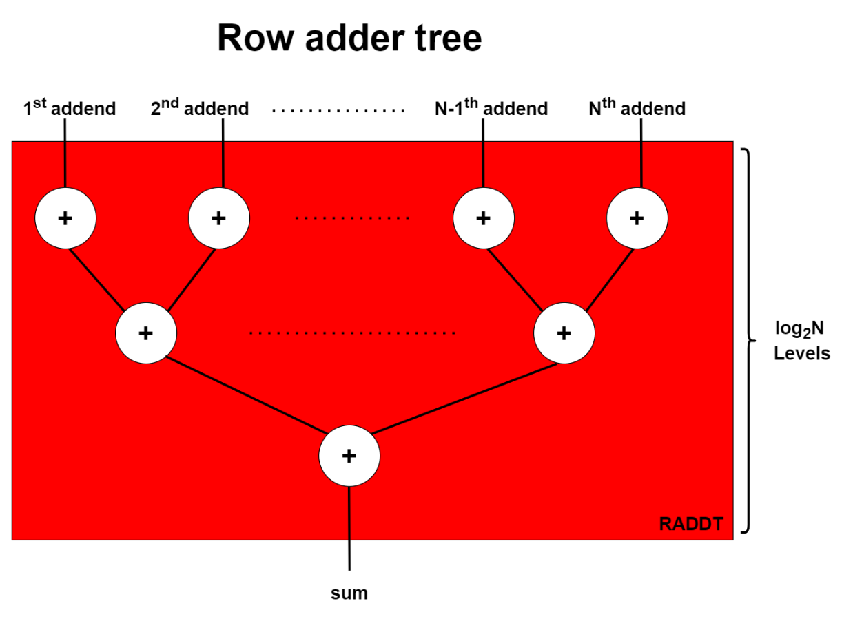
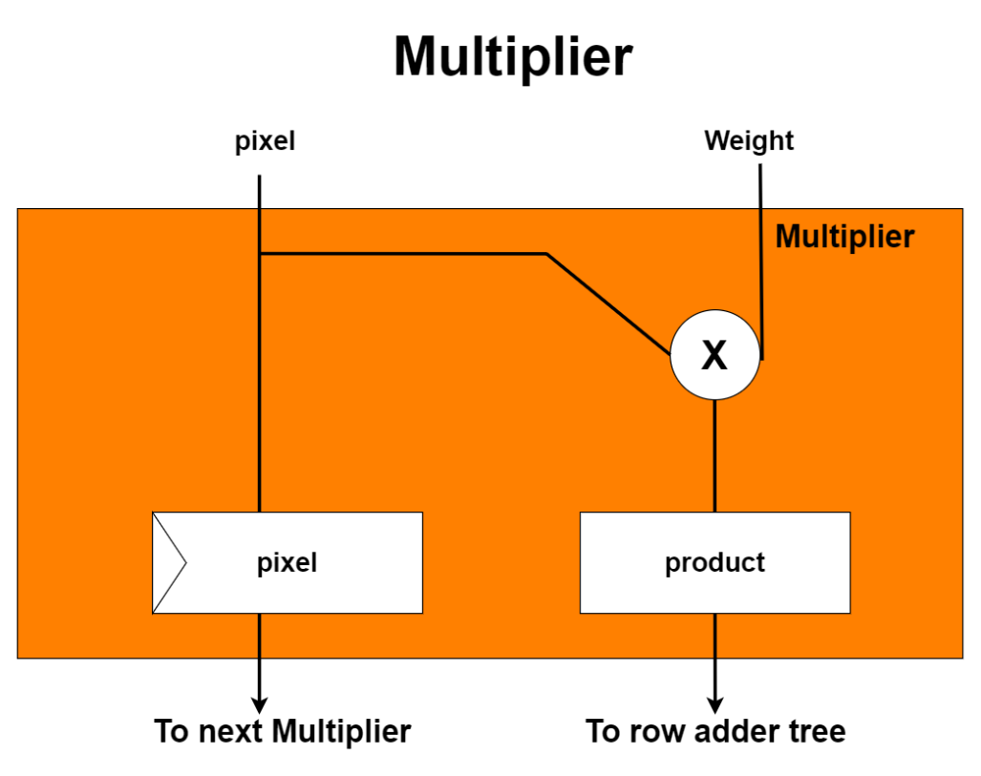

Slide 15
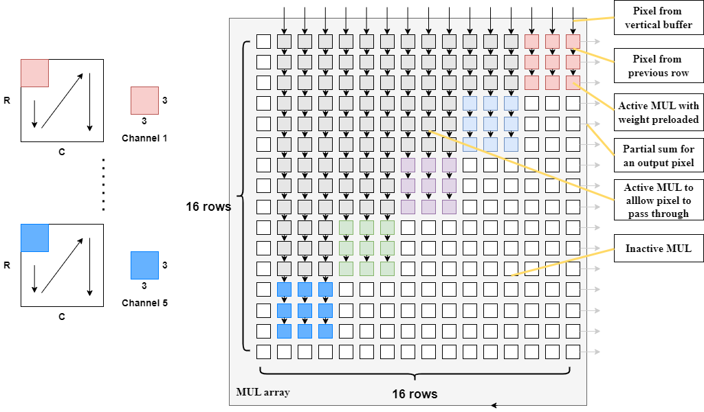
Mapping optimization - Depthwise convolution

Slide 16
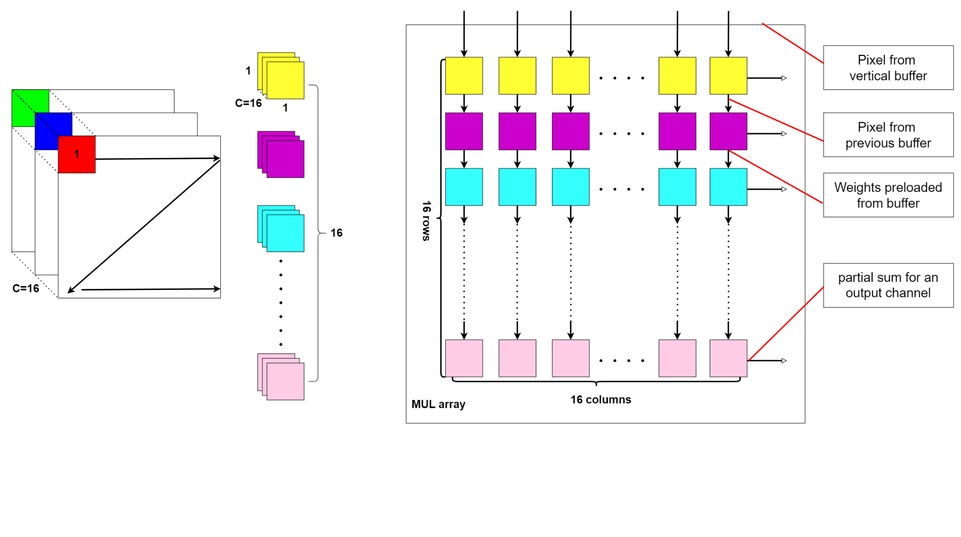
Mapping optimization - pointwise convolution

Slide 17
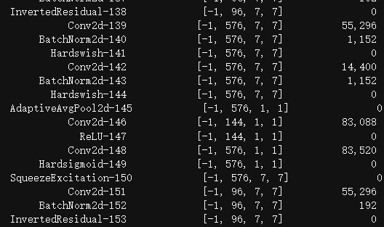
Analysis
DRAM Storage size : 512MB
DRAM size of Pynq z2
DLA Storage size :
Ping-Pong SRAM : 512 KB
112×112×16 = 196 KB
Weight SRAM : 96 KB
144×576 = 81 KB
Buffer size：3 KB
32 bits + 8bits +3 × (16×16×4)

Slide 18
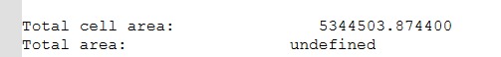
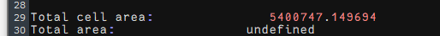
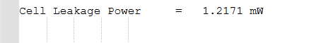
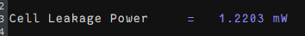
Analysis
Synthesize a single PE under U18 process：
Area：5400747-5344503 = 56244 um2
Power：1.2203-1.2171 = 0.01mW
(a) Only with SRAM
(b) With SRAM and MAC

Slide 19
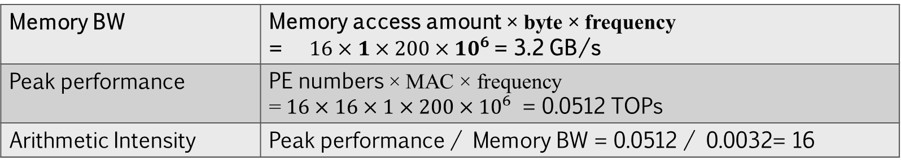
Roofline model calculation
Memory BW | Memory access amount × byte × frequency = $16×1×200×10^{6}$= 3.2 GB/s
Peak performance | PE numbers × MAC × frequency = $16×16×1×200×{10}^{6}$ = 0.0512 TOPs
Arithmetic Intensity | Peak performance / Memory BW = 0.0512 / 0.0032= 16
TOPs/s
0.0032
TOP/byte
16

Slide 20
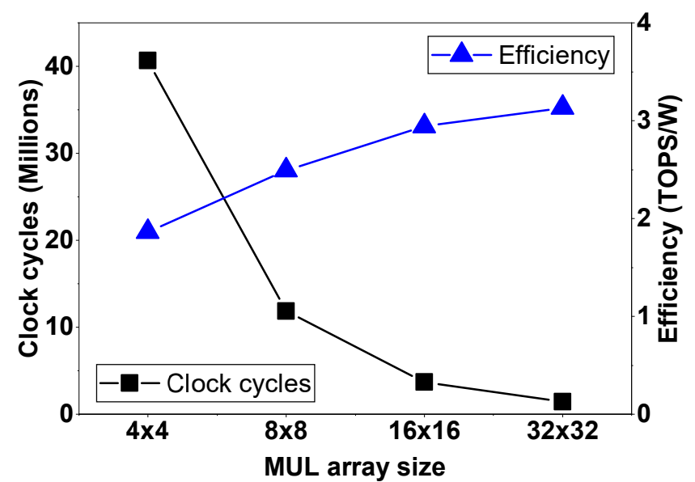
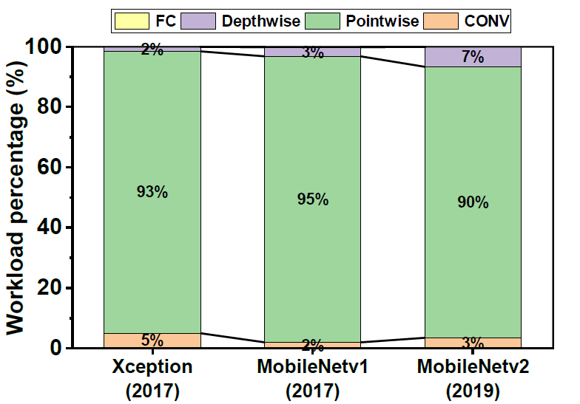
Evaluation

Slide 21
Innovation
Pruning
Power Management
Low Power design
Hardware Reuse

Slide 22
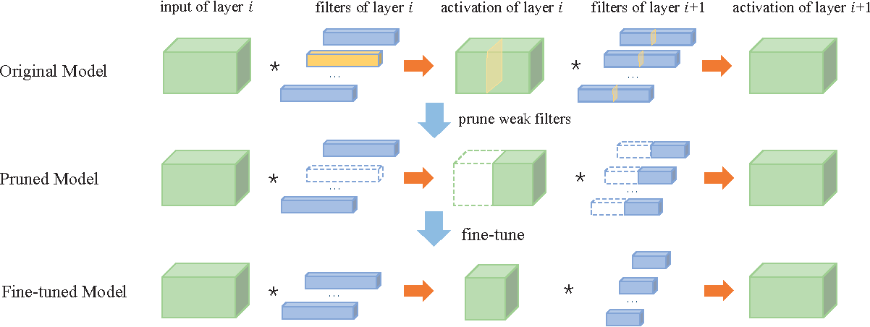
Pruning
Picture from：An Entropy-based Pruning Method for CNN Compression, https://www.semanticscholar.org/paper/An-Entropy-based-Pruning-Method-for-CNN-Compression-Luo-Wu/cda2f01d90d98b71a49b00e34bdc03dc17d67da4

Slide 23
Power Management
Power State | CPU | DLA
Normal | 1.8V | 1.8V
Low Power | 1.6V | 1.6V
Power control by Power management Unit
Apply by using
Power switch
Isolation
Level shifter
Retention

Slide 24

Low Power design
Use zero gating to reduce power consumption because high-zero sparsity
0

Slide 25
Low Power design
Use zero gating to reduce power consumption because high-zero sparsity
0

Slide 26
Global Average Pooling

Slide 27
Global Average Pooling

Slide 28
Global Average Pooling

Slide 29
Global Average Pooling

Slide 30
Global Average Pooling

Slide 31
Global Average Pooling
Achieve global average pooling with systolic array reuse

Slide 32
Roadmap
Hardware synthesize &
APR
Functional
verification
0430~
0507
0508~
0514
0515~
0522
0522~
0531
0601~
0618
Hardware
implementation
Model Training &
Finish testbench
Model evaluation

Slide 33
Reference
Howard, Andrew, et al. "Searching for mobilenetv3." Proceedings of the IEEE/CVF international conference on computer vision. 2019.
Han, Song, Huizi Mao, and William J. Dally. "Deep compression: Compressing deep neural networks with pruning, trained quantization and huffman coding." arXiv preprint arXiv:1510.00149 (2015).
Hu, Jie, Li Shen, and Gang Sun. "Squeeze-and-excitation networks." Proceedings of the IEEE conference on computer vision and pattern recognition. 2018.
Chong, Yi Sheng, et al. "An energy-efficient convolution unit for depthwise separable convolutional neural networks." 2021 IEEE International Symposium on Circuits and Systems (ISCAS). IEEE, 2021.

Slide 34
Q & A

